Slide 1
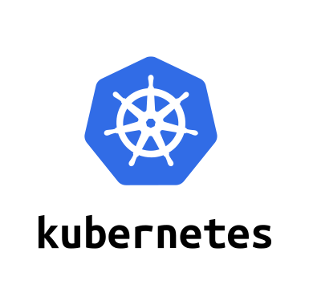
Introduction to Kubernetes

Slide 2
Agenda
Introduction
Container orchestration
Kubernetes
Conclusion

Slide 3
Introduction

Slide 4

Everyone’s container journey starts with one container….

Slide 5
At first the growth is easy to handle….

Slide 6
But soon it is overwhelming… chaos reigns

Slide 7
Regain control with Kubernetes

Slide 8
Container Orchestration

Slide 9
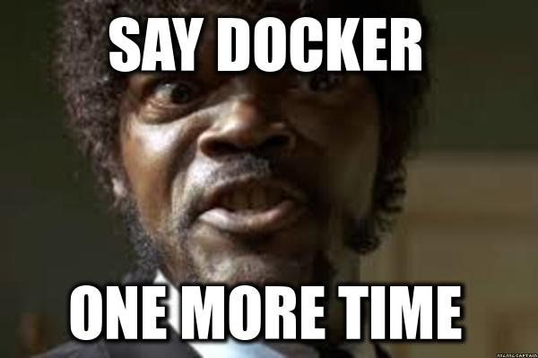


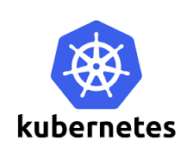




More to Containers than just Docker
Serverless
PaaS
Container Orchestration
Swarm/
Swarm Mode
Container Engine

Slide 10
What is container orchestration?
Container orchestration
Manages the deployment, placement, and lifecycle of workload containers
Cluster management
Federates multiple hosts into one target
Scheduling
Distributes containers across nodes
Service discovery
Knows where the containers are located
Distributes client requests across the containers
Replication
Ensures the right number of nodes and containers
Health management
Replaces unhealthy containers and nodes
Container Orchestrator
Manager
Image Repository
Scheduler
Discovery DB
Replicator
Node
Node
Node
Daemon
Daemon
Daemon
Containers
Containers
Containers

Slide 11


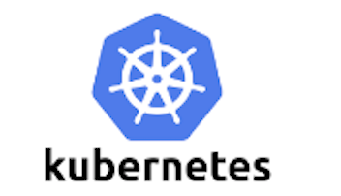




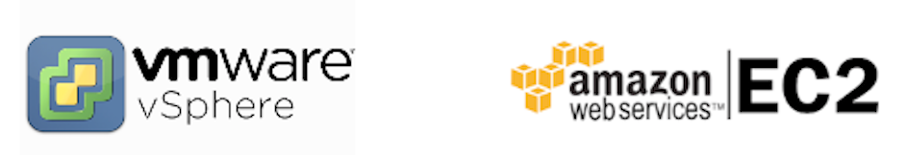
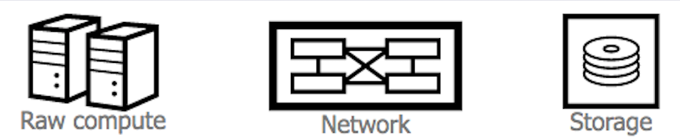
Container Ecosystem Layers
Layer 6
Development Workflow
Opinionated Containers
Layer 5
Orchestration/Scheduling
Service Model
Layer 4
Container Engine
Layer 3
Operating System
Layer 2
Virtual Infrastructure
Layer 1
Physical Infrastructure

Slide 12
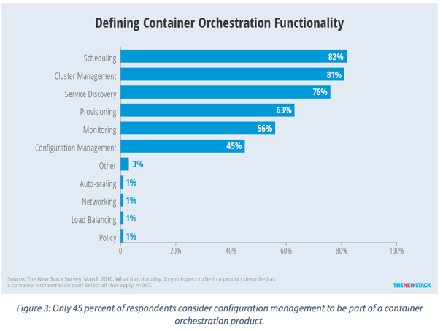
Container Orchestration Responsibilities
Container orchestration
Scheduling
Cluster management
Service discovery
Related functionality
Provisioning
Monitoring
Configuration management

Slide 13
Container Orchestration in IBM Cloud
In June 2015 when IBM Cloud Container Service launched, open source orchestration projects were not available for production
Kubernetes – July 21, 2015
Docker Swarm – November 3, 2015
Apache Mesos – July 27, 2016
IBM developed custom orchestration to ensure anti co-location of containers within a group and container placement to the least utilized hosts
IBM Research runs rigorous performance and scalability testing (https://github.com/Open-I-Beam/containers-os) on various open source projects; then work with those communities to make improvements

Slide 14
Kubernetes

Slide 15
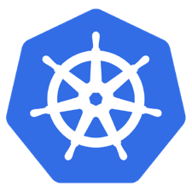
What is Kubernetes?
Container orchestrator
Runs and manages containers
Unified API for deploying web applications, batch jobs, and databases
Maintains and tracks the global view of the cluster
Supports multiple cloud and bare-metal environments
Manage applications, not machines
Rolling updates, canary deploys, and blue-green deployments
Designed for extensibility
Rich ecosystem of plug-ins for scheduling, storage, networking
Open source project managed by the Linux Foundation
Inspired and informed by Google's experiences and internal systems
100% open source, written in Go

Slide 16
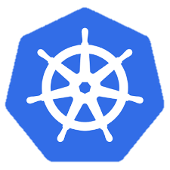
Kubernetes Architecture
internet
Master nodes
Computer with processes that manage the cluster
Multiple nodes for HA
Worker nodes
Computers that host pods
Pods host application containers
kubectl
firewall
Kubernetes cluster
Worker node
kube-proxy
kubelet
docker
pod
pod
pod
Master node
pod
pod
pod
cAdvisor
container
container
authentication authorization
container
container
APIs
container
scheduling
actuator
REST
Worker node
kube-proxy
controller manager
kubelet
Distributed watchable storage (etcd)
docker
pod
pod
pod
pod
pod
pod
cAdvisor
container
container
container
container
container

Slide 17
Kubernetes Terminology: Topology
Cluster
Collection of worker nodes managed by the same master node
Makes the worker nodes behave like one big computer
Master node
Controls and manages the cluster
Scheduling and replication logic
Generally two or more master nodes for resiliency, but are not used for scaling out the cluster
Worker node
Node where pods are run
Docker – Docker engine for running containers (including the kubelet)
kubelet
Kubernetes agent that accepts commands from the master
Manages pods in the node
cAdvisor – Container Advisor provides resources usage and performance statistics
kube-proxy – network proxy service responsible for routing activities for inbound or ingress traffic

Slide 18
Kubernetes Terminology: Master Node Components
Etcd
A highly-available key value store
All cluster data is stored here
API Server
Exposes API for managing Kubernetes
Used by kubectrl CLI
Controller manager
Daemon that runs controllers, which are the background threads that handle routine tasks in the cluster
Node Controller – Responsible for noticing and responding when nodes go down
Replication Controller – Replaced by ReplicaSet
Endpoints Controller – Populates the Endpoints object (that is, joins services and pods)
Service Account & Token Controllers – Create default accounts and API access tokens for new namespaces
Scheduler
Selects the worker node each pods runs in

Slide 19
Kubernetes Architecture: Workloads
Kubernetes components
Container
Packaging of an app
Pod
Unit of deployment
Service
Fixed endpoint for 1+ pods
Master Node
Worker Node 1
Pod
Pod
App A
App B
App A Client
App A Service
Worker Node 2
Pod
Pod
App B
App A
App B Client
App B Service
Worker Node 3
Pod
Pod
App A
App B

Slide 20
Kubernetes Terminology: Workloads
Container
Unit of packaging
Pod
Smallest deployment unit in Kubernetes
A collection of containers that run on a worker node
Each pod has its own IP
A pod shares a PID namespace, network, and hostname
Service
Collection of pods exposed as an endpoint
Information stored in the Kubernetes cluster state and networking info propagated to all worker nodes
Types
ClusterIP – Exposes the service on a cluster-internal IP
NodePort – Exposes the service on each Node’s IP at a static port
LoadBalancer – Exposes the service externally using a cloud provider’s load balancer
ExternalName – Maps the service to an external name (such as foo.bar.example.com)

Slide 21
Kubernetes Terminology: Deployment
Deployment
A set of pods to be deployed together, such as an application
Declarative: Revising a Deployment creates a ReplicaSet describing the desired state
Rollout: Deployment controller changes the actual state to the desired state at a controlled rate
Rollback: Each Deployment revision can be rolled back
Scale and autoscale: A Deployment can be scaled
ReplicaSet
The next-generation ReplicationController
A set of pod templates that describe a set of pod replicas
Uses a template that describes specifically what each pod should contain
Ensures that a specified number of pod replicas are running at any given time
Deployment
create
ReplicaSet 1
Deployment
rollback
rollout
ReplicaSet 1
ReplicaSet 2
rolling update
pod
pod
pod
ReplicaSet 2
svcA
svcA
svcB

Slide 22
Kubernetes Autoscaling
Horizontal Pod Autoscaling (HPA)
Automatically scales the number of pods in a replication controller, deployment, or replica set
Matches the observed average CPU utilization to the specified target
Fetches metrics in two different ways: direct Heapster access and REST client access
Kubernetes Heapster enables container cluster monitoring and performance analysis
Default config: query every 30 sec, maintain 10% tolerance, wait 3 min after scale-up, wait 5 min after scale-down
$ kubectl autoscale deployment <deployment-name> --cpu-percent=50 --min=1 --max=10 deployment ”<hpa-name>" autoscaled
Creates a horizontal pod autoscaler
An HPA instance
Maintains between 1 and 10 replicas of the pods controlled by the deployment
Maintains an average CPU utilization across all pods of 50%

Slide 23
Kubernetes Terminology: Naming
Name
Each resource object by type has a unique name
Namespace
Resource isolation: Each namespace is a virtual cluster within the physical cluster
Resource objects are scoped within namespaces
Low-level resources are not in namespaces: nodes, persistent volumes, and namespaces themselves
Names of resources need to be unique within a namespace, but not across namespaces
Resource quotas: Namespaces can divide cluster resources
Initial namespaces
default – The default namespace for objects with no other namespace
kube-system – The namespace for objects created by the Kubernetes system
Resource Quota
Limits resource consumption per namespace
Limit can be number of resource objects by type (pods, services, etc.)
Limit can be total amount of compute resources (CPU, memory, etc.)
Overcommit is allowed; contention is handled on a first-come, first-served basis

Slide 24
Kubernetes Configuring Resources and Containers
Label
Metadata assigned to Kubernetes resources (pods, services, etc.)
Key-value pairs for identification
Critical to Kubernetes as it relies on querying the cluster for resources that have certain labels
Selector
An expression that matches labels to identify related resources
ConfigMap
Configuration values to be used by containers in a pod
Stores configuration outside of the container image, making containers more reusable
Secrets
Sensitive info that containers need to read or consume
Encrypted in special volumes mounted automatically

Slide 25
Kubernetes Architecture
UI
Kubernetes Master
Worker Node 1
Worker Node 2
API
Worker Node 3
CLI
Worker Node n
Registry
Etcd
API Server
Controller Manager Server
Scheduler

Slide 26
Kubectl Commands
Get the state of your cluster
$ kubectl cluster-info
Get all the nodes of your cluster
$ kubectl get nodes -o wide
Get info about the pods of your cluster
$ kubectl get pods -o wide
Get info about the replication controllers of your cluster
$ kubectl get rc -o wide
Get info about the services of your cluster
$ kubectl get services
Get full config info about a Service
$ kubectl get service NAME_OF_SERVICE -o json
Get the IP of a Pod
$ kubectl get pod NAME_OF_POD -template={{.status.podIP}}
Delete a Pod
$ kubectl delete pod NAME
Delete a Service
$ kubectl delete service NAME_OF_SERVICE

Slide 27
Kubernetes Capabilities

Slide 28






Kubernetes Capabilities
Intelligent Scheduling
Self-healing
Horizontal scaling
Service discovery & load balancing
Automated rollouts and rollbacks
Secret and configuration management

Slide 29
Horizontal scaling
Scale your application with a simple command
Automatic scaling based on real-time usage

Slide 30
Intelligent Scheduling
Automatically places containers based on required resources
Supports mixed workloads to drive increased utilization

Slide 31
Service discovery and load balancing
Simple discovery of services through a single DNS name
Manage access to container applications through IP address or HTTP route
Automatically load balance traffic and route around failure

Slide 32
Automated rollouts and rollbacks
Roll out changes to your application or its configuration
While monitoring application health to ensure things stay up
If something goes wrong, Kubernetes will rollback the change for you

Slide 33
Self-healing
Restarts containers that fail
Replaces and reschedules containers when nodes die
Kills containers that don't respond to your user-defined health check

Slide 34
Secret and configuration management
Safely store application credentials and secrets
Deploy and update secrets and application configuration
Without rebuilding your image
Without exposing secrets in your stack configuration

Slide 35
Conclusion

Slide 36
Conclusion
Container orchestration
Kubernetes

Slide 37
Resources
Kubernetes tutorial
https://kubernetes.io/docs/tutorials/kubernetes-basics/
Introduction to container orchestration
https://www.exoscale.ch/syslog/2016/07/26/container-orch/
TNS Research: The Present State of Container Orchestration
https://thenewstack.io/tns-research-present-state-container-orchestration/
Large-scale cluster management at Google with Borg
https://research.google.com/pubs/pub43438.html

